Slide 1
A 3.2.4 Constructing tables
In relational databases, data is organised into tables. How these tables are structured and how they relate to each other is fundamental to the database's effectiveness. This section explores the principles of table construction and the crucial role of keys in defining relationships.

Slide 2
Learning Objective:
Understand how data is organised into tables in a relational database.
Learn the principles of table construction and the role of primary and foreign keys in defining relationships.

Slide 3
IB Approaches to Learning (ATL) Skill:
Thinking Skills → Critical Thinking:
  Students analyse how tables and keys structure data to make meaning.
  Evaluate the effectiveness of different table designs for retrieving information.
Communication Skills → Collaboration:
  Working in pairs to design tables and define relationships encourages discussion and justification of design choices.
Self-Management → Organization:
  Organising data into tables mirrors how students organise knowledge, promoting structured thinking.
Knowledge Question (TOK-style):
How does the way we structure information influence what we can know and understand?

Slide 4
STARTER
Activity: Organising Your Backpack
Prompt: “Imagine you are organising items in your school bag into categories (books, stationery, gadgets, snacks). How would you structure this list so you can find things quickly?”
Students do a 1-min brainstorm, then Think–Pair–Share their categories.
Teacher connects idea → “Just like you grouped your items, in a relational database we structure data into tables. Today, we’ll learn how.”

Slide 5
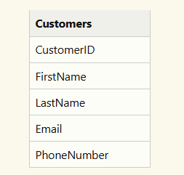
Constructing Tables for Relational Databases
A table in a relational database is composed of rows (also called records) and columns (also called fields). Each column stores a specific type of data (as we discussed in A.3.2.3), and each row represents a single instance of the entity the table describes.
Key Considerations for Table Construction:
Entity Focus: Each table should represent a single, well-defined entity (e.g., "Customers," "Orders," "Products"). For example:
Atomic Columns: Columns should store atomic (indivisible) data. For example:
Instead of: Name (VARCHAR)
Use: FirstName (VARCHAR), LastName (VARCHAR)

Slide 6
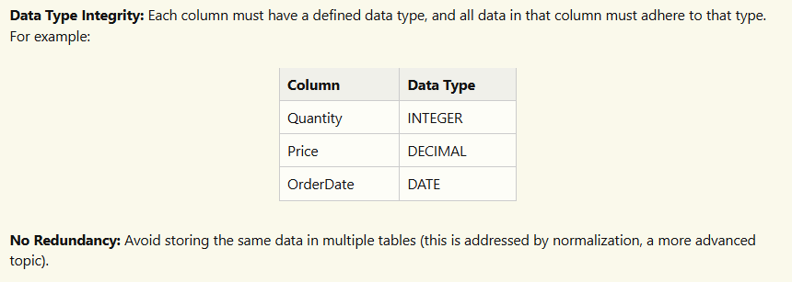

Slide 7
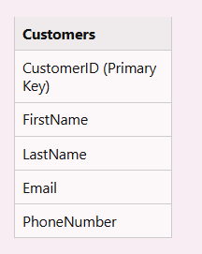
The Relationship Between Tables
Relational databases derive their power from the relationships between tables. These relationships are established and managed using keys:
Primary Key:
A primary key is a column (or a set of columns) that uniquely identifies each row in a table.
It must contain unique values.
It cannot contain NULL (empty) values.
Example: In a "Customers" table, "CustomerID" is often the primary key.

Slide 8
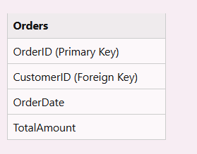
Foreign Key:
A foreign key is a column (or set of columns) in one table that refers to the primary key in another table.
It establishes a link between the two tables.
Example: In an "Orders" table, "CustomerID" would be a foreign key, linking each order to the customer who placed it in the "Customers" table.

Slide 9

Composite Key:
A composite key is a primary key that consists of two or more columns.
It's used when a single column cannot uniquely identify a row.
Example: In a table tracking student enrollment in courses, the composite key might be ("StudentID," "CourseID") since a student can enroll in multiple courses, and a course has multiple students.

Slide 10
Concatenated Key
In some contexts, "concatenated key" might refer to the value formed by combining multiple columns (not strictly a key type like the others).
More accurately, if those concatenated values are used as a key, it is a composite key.
Example: If you combine "FirstName" and "LastName" to search for a record, you're using a concatenated value, but if those two columns together are the table's unique identifier, it's a composite key.

Slide 11
The Importance of Well-Defined Tables in Ensuring Data Integrity
Well-defined tables are crucial for maintaining data integrity, which refers to the accuracy and consistency of data stored in the database.
Benefits of Well-Defined Tables:
  Reduced Redundancy: Proper table design minimizes data duplication, saving storage space and preventing inconsistencies.
  Data Accuracy: Constraints (like primary key uniqueness and data types) enforce rules about the data that can be entered, reducing errors.
  Consistency: Relationships defined by keys ensure that data across tables is consistent. For example, a foreign key ensures that you can't have an order referring to a non-existent customer.
  Efficient Retrieval: Well-structured tables make it easier and faster to retrieve the needed information.
  Ease of Maintenance: Changes to the database schema are easier to manage when tables are well-defined.

Slide 12
Challenge
What is the purpose of a primary key in a relational database table?
Explain how a foreign key is used to create a relationship between two tables.
When would you use a composite key instead of a single-column primary key?
Describe two ways that well-defined tables contribute to data integrity.

Slide 13
IB EXAM STYLE QUESTIONS
Section A – Short-Answer Questions (Knowledge & Understanding)
Define a primary key in a relational database. [2]
Explain the purpose of a foreign key. [3]
Describe what a table represents in a relational database. [2]
Identify two advantages of using tables to organise data. [2]
Outline one principle of table construction that helps reduce data redundancy. [2]

Slide 14
Section B – Extended-Response Questions (Application & Analysis)
A school wants to store information about Students, Courses, and Enrollments.
(a) Design the tables including at least three attributes for each. [6]
(b) Identify the primary key for each table and explain your choice. [6]
(c) Suggest foreign keys and describe the relationships between the tables. [6]
Consider an online bookstore database. Analyse how primary and foreign keys support accurate and efficient data retrieval. [8]
To what extent does the way a database is structured into tables affect the knowledge that can be extracted from it? Provide examples to support your answer. [10]

